Slide 1
What is REST
REST stands for Representational State Transfer.
It is an architectural style (not a framework or protocol) used to design web services that communicate over HTTP.
In simple words —
REST defines a set of rules for how clients (like browsers or mobile apps) should interact with servers.

Slide 2
Key REST Principles
1. Client–Server Architecture
The client (like Angular, React, or mobile app) and the server (your ASP.NET Core API) are separate.
Client requests data, server sends back a response.
This separation improves scalability and independence.
Example:
Client: Sends GET /api/products
Server: Returns product list in JSON.

Slide 3
Key REST Principles
2. Stateless
Every request from the client to the server must contain all necessary information to understand and process it.
The server does not store any client session or state.
Example: If the client sends:
GET /api/products
Authorization: Bearer <token>
The server uses that token to verify the client — it doesn’t remember the user from previous requests.

Slide 4
Key REST Principles
3. Resources and URIs
In REST, everything is a resource — like Product, Order, Customer.
Each resource is identified by a unique URI (Uniform Resource Identifier).
Example:
/api/products/10 → Product with ID 10
/api/customers/3 → Customer with ID 3

Slide 5
Key REST Principles
4. Use of HTTP Methods
REST uses standard HTTP methods to perform operations on resources.
HTTP Method | Purpose | Example | Description
GET | Retrieve data | /api/products | Fetch all products
GET (id) | Retrieve single item | /api/products/5 | Fetch product with ID 5
POST | Create a new resource | /api/products | Add a new product
PUT | Update an existing resource | /api/products/5 | Replace product 5
PATCH | Partially update resource | /api/products/5 | Update product name only
DELETE | Delete a resource | /api/products/5 | Remove product 5

Slide 6
Key REST Principles
5. Representation
A resource can be represented in multiple formats:
JSON (most common)
XML
YAML
HTML

Slide 7
Key REST Principles
6. Uniform Interface
REST has a consistent way of interacting with resources — this uniformity simplifies development.
It includes:
Standard HTTP methods (GET, POST, PUT, DELETE)
Consistent URI naming
Use of status codes (200, 201, 404, 500, etc.)
Use of representations (JSON, XML)

Slide 8
Key REST Principles
7. Cacheable
Responses from the server can be cached by the client to improve performance.
Example: A list of products that rarely changes can be cached for 10 minutes.
8. Layered System
REST allows layered architecture — client doesn’t know if it’s talking to the actual server or a proxy/load balancer.
This improves security and scalability.

Slide 9
RESTful vs Non-RESTful APIs
RESTful API | Non-RESTful API
Uses HTTP verbs properly | Uses only POST for everything
Stateless | Stores session info
Resource-based URLs | Action-based URLs
/api/products/5 | /api/getProductById?id=5
Returns JSON | Might return HTML

Slide 10
Example — REST in Action (E-Commerce)
Operation | HTTP Method | Endpoint | Request Body | Response
Get all products | GET | /api/products | — | List of products
Get one product | GET | /api/products/2 | — | Product with ID 2
Add a product | POST | /api/products | { "name": "Mouse", "price": 500 } | 201 Created
Update product | PUT | /api/products/2 | { "id": 2, "name": "Wireless Mouse", "price": 800 } | 200 OK
Delete product | DELETE | /api/products/2 | — | 204 No Content

Slide 11
Key REST Principles
Advantages of REST
Simple and easy to understand
Lightweight and fast
Works with multiple data formats (JSON, XML)
Scalable and stateless
Widely supported by clients and tools (Postman, browsers, etc.)

Slide 12
What is Web API/Rest API
A Web API (Application Programming Interface) is a way for applications to communicate with each other over the web — usually using HTTP.
In simple terms, it’s a back-end service that receives requests (data) from a client (like Angular, React, or mobile apps) and sends back responses (usually in JSON format).
Think of it as a messenger between client and server.

Slide 13
Key Characteristics of Web APIs
HTTP-Based Communication: Web APIs are designed to work over HTTP, the same protocol used for Web Browsing. This means APIs can be accessed using standard HTTP methods like GET, POST, PUT, DELETE, etc. The API endpoints are typically represented as URLs (Uniform Resource Locators).
Data Exchange Formats: Web APIs use standardized data exchange formats such as JSON (JavaScript Object Notation) and XML (Extensible Markup Language) to structure and transmit data between the client and server. JSON has become the most popular format due to its simplicity and ease of use.
RESTful Architecture: Web APIs are designed to follow Representational State Transfer (REST) principles. A RESTful API is stateless, uses standard HTTP methods, and organizes resources into a hierarchy with unique URLs for each resource.
Authentication and Authorization: Web APIs implement security mechanisms for authentication and authorization to ensure that only authorized clients can access resources or perform specific actions. Common authentication methods include API keys, OAuth, and JWT (JSON Web Tokens).

Slide 14
ASP.NET Core Web API?
ASP.NET Core Web API is a framework by Microsoft used to build HTTP-based services that follow the REST architectural style.
It allows different applications — such as web apps, mobile apps, IoT devices, or third-party systems — to communicate with your backend through HTTP requests and JSON responses.
💬 Think of it as:
A bridge between your server-side logic (database, business rules) and the client-side app (like Angular, React, or mobile app).
Notes:
What are IOTs The term IOTs stands for Internet Of Things. Internet Of Things are the objects or devices that have an IP address and can communicate over the internet with other internet enabled devices and objects. Examples for IoT include security systems, electronic appliances, thermostats, cars etc..., in addition to desktops, laptops, and smart phones.

Slide 15
ASP.NET Core Web API Features
Cross-Platform Support: NET Core Web APIs can run on Windows, Linux, and macOS, making your Web APIs platform-independent.
Performance: NET Core has been designed to have a smaller memory footprint and improved performance compared to its predecessors. It’s optimized for modern cloud-based applications.
Routing: Supports attribute routing, which allows the development of -SEO-friendly URLs.
Model Binding and Validation: Automatically maps data from HTTP requests to action method parameters. Model validation is also automatically performed, and any validation errors can be handled and returned to the client.
Dependency Injection: Built-in support for dependency injection (DI). This allows for more modular and testable code.
Middleware Support: NET Core’s middleware pipeline enables you to add components that inspect and process HTTP requests/responses, allowing for custom processing like authentication, logging, encryption decryption, etc.
Content Negotiation and Serialization: Automatically serializes your data to and from JSON, XML, or any other format, depending on client preferences and server capabilities.
Notes:
What are IOTs The term IOTs stands for Internet Of Things. Internet Of Things are the objects or devices that have an IP address and can communicate over the internet with other internet enabled devices and objects. Examples for IoT include security systems, electronic appliances, thermostats, cars etc..., in addition to desktops, laptops, and smart phones.

Slide 16
Why Use ASP.NET Core for Web API?
Feature | Description
Cross-platform | Runs on Windows, Linux, macOS
High Performance | ASP.NET Core is one of the fastest web frameworks
Open Source | Fully open-source on GitHub
Dependency Injection (DI) | Built-in — helps write clean and testable code
Middleware Pipeline | Fully customizable request handling
Security | Built-in authentication & authorization (JWT, Identity)
Swagger Support | Built-in documentation generation
Entity Framework Core | Easy database integration (SQL Server, SQLite, PostgreSQL, etc.)
Notes:
What are IOTs The term IOTs stands for Internet Of Things. Internet Of Things are the objects or devices that have an IP address and can communicate over the internet with other internet enabled devices and objects. Examples for IoT include security systems, electronic appliances, thermostats, cars etc..., in addition to desktops, laptops, and smart phones.

Slide 17
Explanation of Layers:
Layer | Purpose
Controller | Handles HTTP requests/responses
Service Layer | Contains business logic
Repository Layer | Talks to the database (via EF Core)
Model | Represents data (classes/DTOs)
DbContext | EF Core’s bridge between code and database
Program.cs | Entry point — configures app and services
Notes:
What are IOTs The term IOTs stands for Internet Of Things. Internet Of Things are the objects or devices that have an IP address and can communicate over the internet with other internet enabled devices and objects. Examples for IoT include security systems, electronic appliances, thermostats, cars etc..., in addition to desktops, laptops, and smart phones.

Slide 18
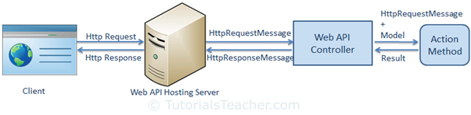
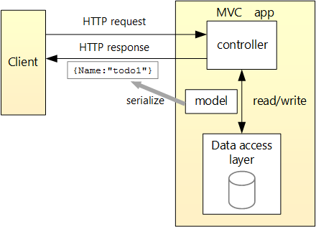
request/response pipeline in Asp.net Core Web API

Slide 19
How a Request Flows in ASP.NET Core Web API
Client sends HTTP request → (e.g., GET /api/products)
The request enters the Middleware Pipeline
Routing Middleware finds the correct controller and action
Controller Action is executed
Controller calls Service Layer (if separated)
Service Layer calls Repository (data access)
Repository interacts with Database
Data flows back → Repository → Service → Controller → Client (as JSON)

Slide 20
Asp.net Core API Useful Features
Feature | Description
Model Binding | Automatically maps JSON → C# object
Model Validation | Add [Required], [Range] attributes for validation
Dependency Injection (DI) | Easily inject services like IProductService
Swagger UI | Auto-generated API documentation (easy testing)
Filters | Custom logic before/after actions (e.g., logging, validation)
Middleware | Global request pipeline customization
Authentication | Supports JWT, OAuth, Identity
Versioning | Manage multiple API versions easily

Slide 21
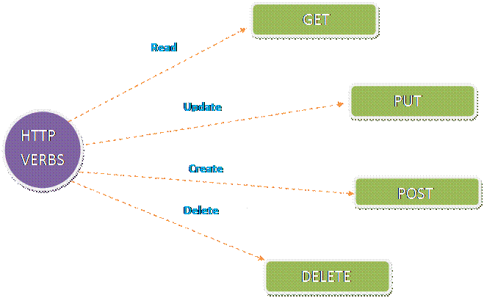
HTTP Verbs in ASP.NET Core Web API
One of the key features of HTTP is the use of verbs (also known as methods or actions) to perform specific operations on resources.
In the context of ASP.NET Web API, these HTTP verbs are used to create, read, update, and delete data.
The following are the five most commonly used HTTP verbs in the ASP.NET Core Web API
Get
Post
Put
Delete

Slide 22
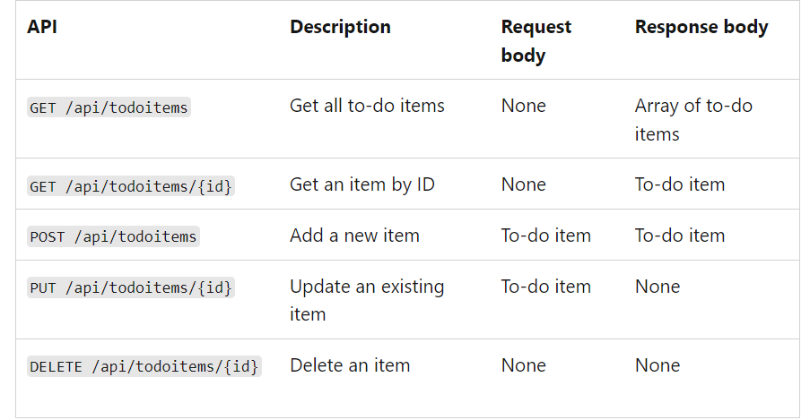
HTTP Verbs in ASP.NET Core Web API

Slide 23
HTTP GET
This verb is used to retrieve data from the server.
It is a read-only operation that does not change any data on the server.
A GET request is used to retrieve a representation of a resource from the server.
Example:
The following endpoint retrieves a list of all employees.
GET /api/Employee/ListEmployees

Slide 24
HTTP POST
This verb is used to create new data on the server.
It is a write operation that adds a new resource to the server.
A POST request is used to submit an entity to the specified resource, often causing a change in state on the server.
Example:
The following endpoint create or add the employee.
POST /api/Employee/CreateEmployee .

Slide 25
HTTP PUT
This verb is used to update existing data on the server.
It is a write operation that replaces an existing resource with a new one.
A PUT request is used to update a resource with the client-provided data.
Example:
The following endpoint updates employee with ID 1.
PUT /api/Employee/updateEmployee/1 .

Slide 26
HTTP DELETE
This verb is used to delete data on the server.
It is a write operation that removes a resource from the server.
A DELETE request is used to delete a resource identified by a URI.
Example:
The following endpoint deletes employee with ID 1.
DELETE /api/Employee/deleteEmloyee/1.

Slide 27
Selecting The Appropriate Method
A large portion of application functionality can be summed up in the acronym CRUD, which stands for Create, Read, Update, Delete. There are four HTTP methods that correspond to these actions, one for each, like so:
C - Create - POST
R - Read - GET
U - Update - PUT
D - Delete - DELETE

